Slide 1
Deep Active Learning for Real-World Challenges
Min Xu
Computational Biology Department
CMU
Email: mxu1@cs.cmu.edu

Slide 2
Motivation
Deep learning
popular in a lot of tasks
Unsupervised or semi-supervised learning
performance is bound to that of supervised learning
Supervised learning (reliable)
However, huge amount of labeled data
What if there is no sufficient labeled data

Slide 3
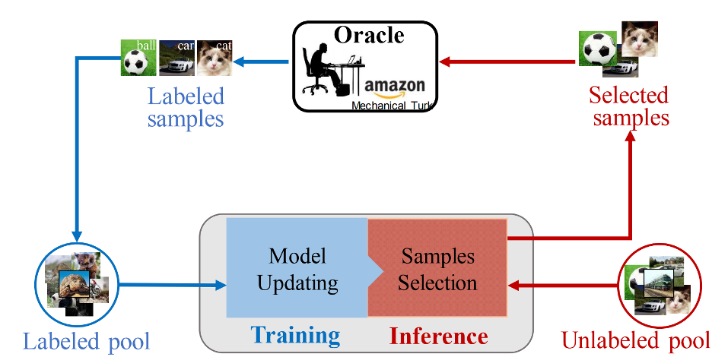
One Solution - Active Learning

Slide 4

What is behind
Uncertainty Estimation
the most uncertain data will be selected for annotation

Slide 5
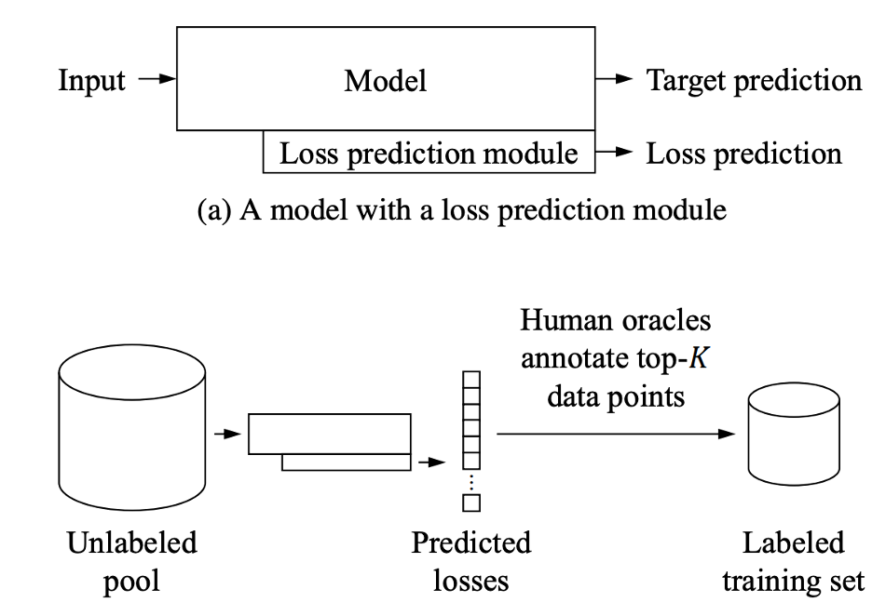
Existing Methods
Learning loss for active learning (LL4AL) https://arxiv.org/pdf/1905.03677.pdf

Slide 6
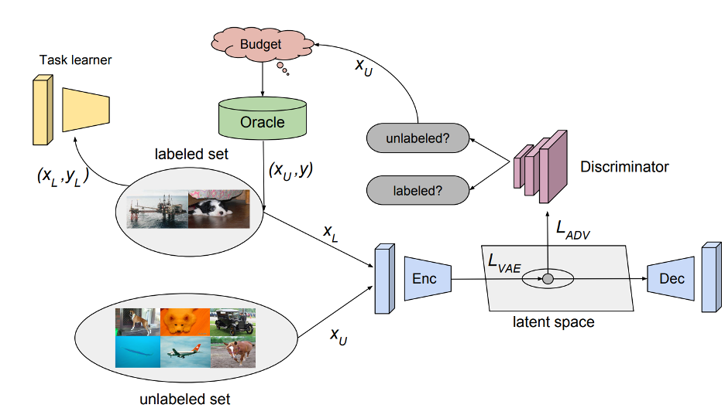
Existing Methods (Cont.)
Variational adversarial active learning (vaal) https://arxiv.org/pdf/1904.00370.pdf

Slide 7
Challenges
Auxiliary models
complex model
multiple auxiliary models may be needed (inefficient training)
How to define uncertainty
loss?
something else?

Slide 8
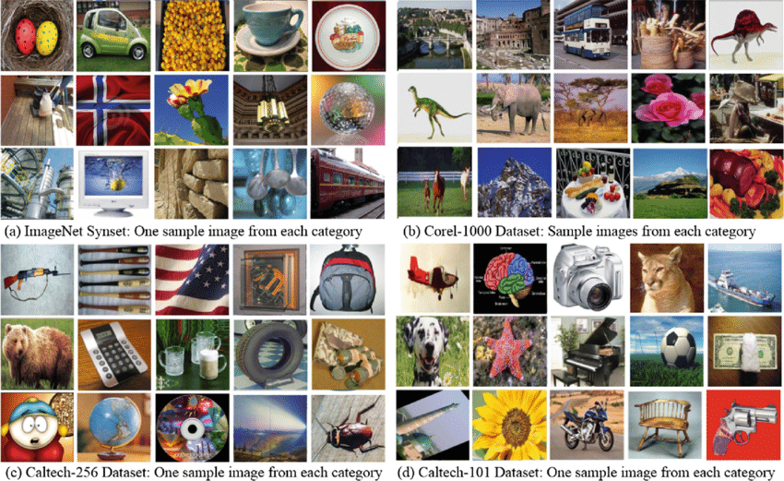
Applications
Typical computer vision tasks

Slide 9
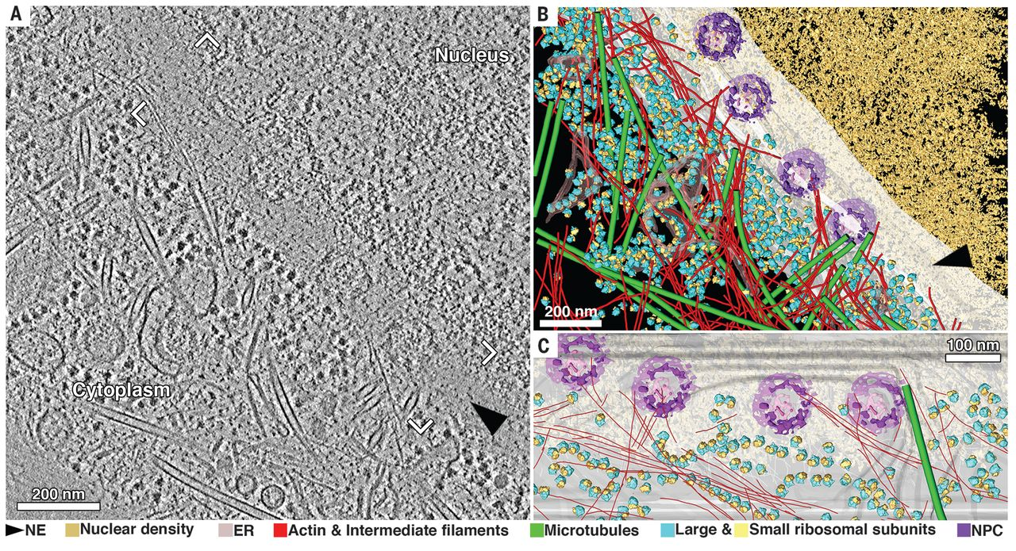
Applications (cont.)
Cryo-electron tomography tasks
Cryo-electron tomography tasks

Slide 10
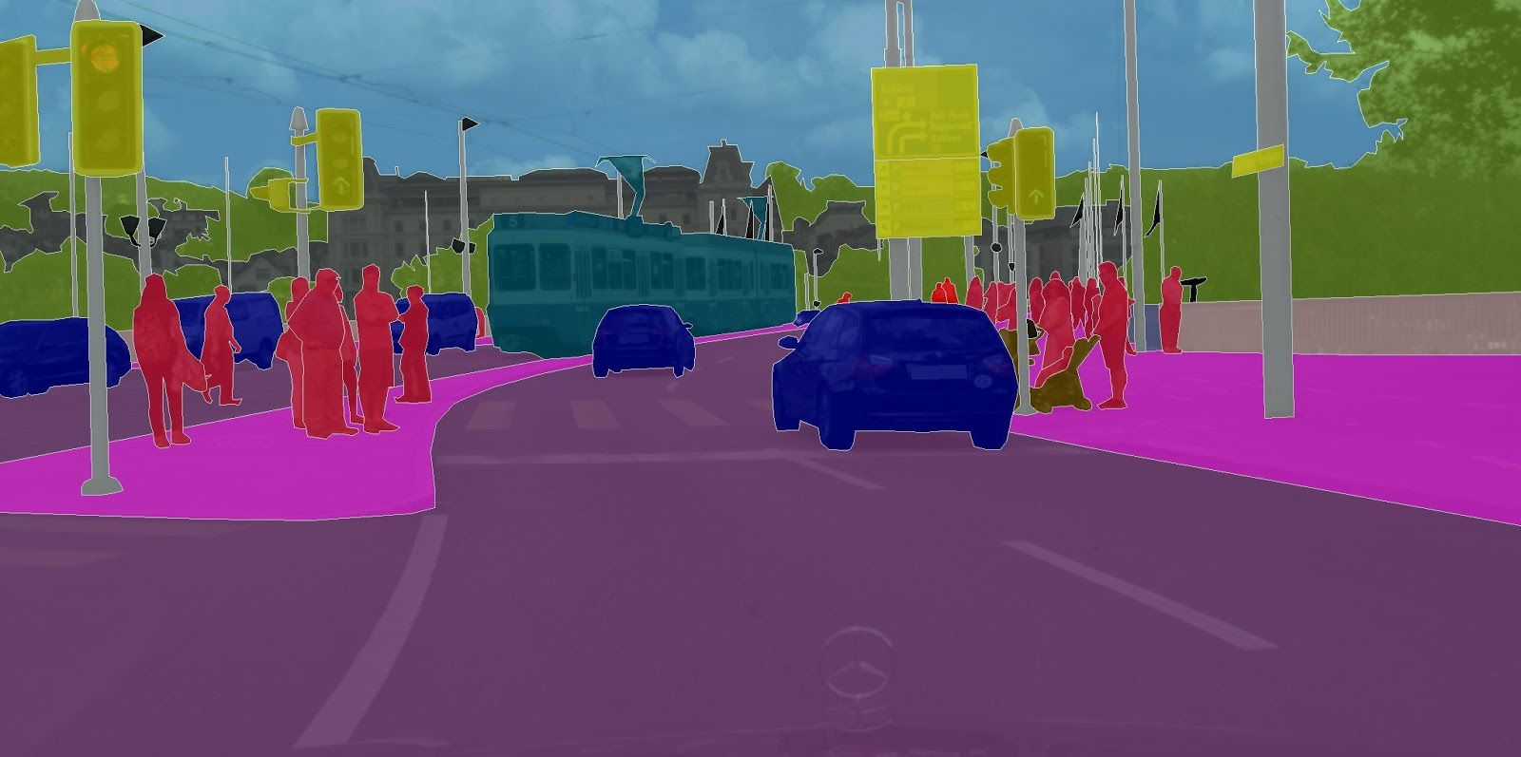
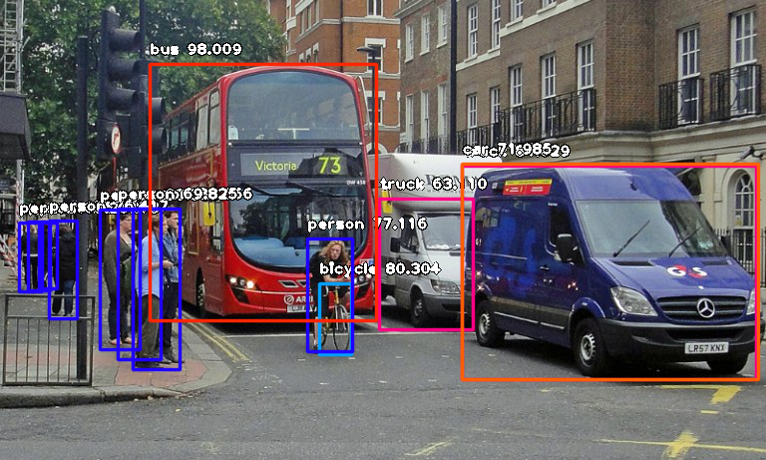
Applications
Various task modalities

Slide 11
Our Project
Simplify the pipeline
fewer yet more effective auxiliary model (even no auxiliary model)
Define and estimate data uncertainty
theoretical and experimental analysis

Slide 12
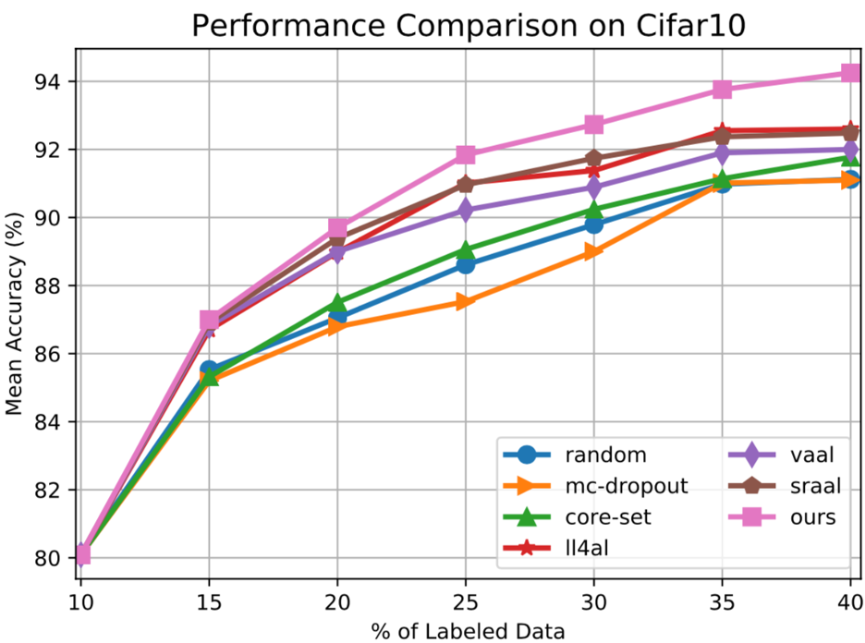
Example Results
Computer vision tasks
unpublished results (please DO NOT distribute)

Slide 13
Opportunity
We welcome you to join the team
goal: publish high-impact papers
Support from our lab
research advising
GPU time
Your skills
solid knowledge of deep learning and computer vision
solid experience of coding with Python and Pytorch
solid math knowledge and skills

Slide 14
The End

